Slide 1
HOLICONG MIDDLE SCHOOL PARENT COUNCIL
October 20, 2022

Slide 2
HOLICONG MIDDLE SCHOOL PARENT COUNCIL October 20, 2022
Tips & Format
Camera & Video off when join
If able – have website browser open to navigate/follow along on your own website
Use chat feature to ask questions on topic “in the moment” if someone presenting and don’t want to forget or interrupt – we monitor the chat & will also put links in the chat
Agenda – Allows for approximately 5 minutes of “presentation” from our staff and time for questions live or in chat

Slide 3
Parent Council Norms & Values
Be Considerate – of other people’s thoughts and opinions
Be Responsible – ready to begin on time, be prepared, and maintain joy
Be Healthy – create a safe meeting environment where all feel comfortable
Be Respectful – of the time and feelings of attendees and presenters

Slide 4
Agenda
Superintendent Parent Advisory Update – Dr. Shillingford
Technology – Mrs. Lovuolo & Mr. Striano
Athletics – Mr. Rittenhouse
Music – Mrs. Repper, Mr. Chodoroff, & Mr. Glaser
Student Services – Mrs. Louderback, Mr. Striano, & Ms. Pierangeli
Student Activities – Mrs. Wentz
School & District Updates – Mr. Canelli & Dr. Shillingford

Slide 5
Parent Superintendent Report Mrs. Bliss
Please reach out with feedback, suggestions, or questions to bring to Superintendent Parent Advisory or Holicong Administration
Contact Information
Sarah Bliss
sbliss321@comcast.net
1st Superintendent Parent Advisory
Primary Topics
Student Focus Groups
Portrait of a Graduate

Slide 7
School Calendar & Updates
Thursday, October 20
PSSA Score Reports – Going Home in I & E
Rho Kappa Induction Ceremony
Parent Council @ 9:00 AM & 6:00 PM
Monday, October 24
CBSD CLOSED – OFFICES OPEN (Diwali)
Friday, October 28
CBSD CLOSED – OFFICES OPEN (Diwali)
Monday, October 31
RAS & Student Leadership Halloween Contest
Early Dismissal for Students; Staff Development
Friday, November 4
Holicong Coffeehouse!
End of Marking Period 1 Early Dismissal for Students; Staff Development – Clerical
Tuesday, November 8
CBSD CLOSED – OFFICES OPEN (General Election)

Slide 8
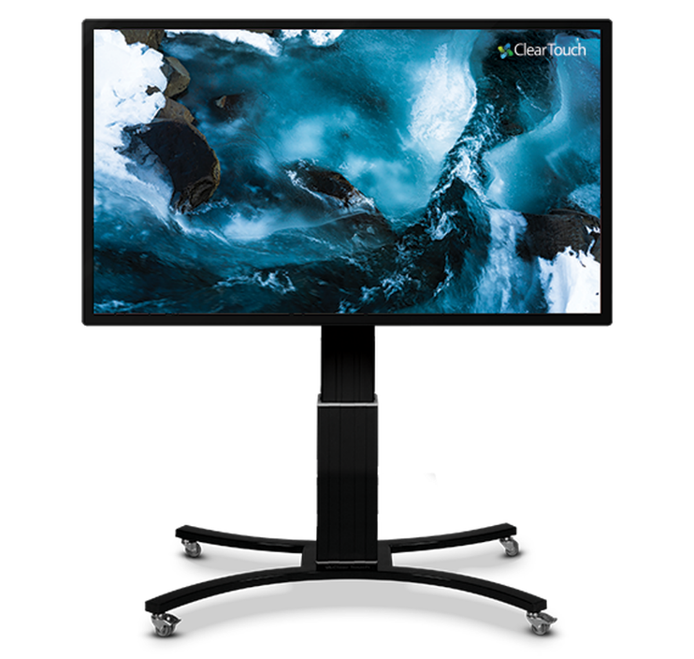
Technology Mrs. Lovuolo & Mr. Striano
What are they? Mobile 7th inch, 4K resolution interactive whiteboards that provide flexible learning options.
Why is the district purchasing these? They provide up to date technology, flexibility, and a cost benefit long-term over the current smartboards.
Who has them? We currently have 22 teachers at Holicong with the panels.
How are they used?
How are they used? Let’s find out from Mrs. Lovuolo!

Slide 9
Athletics Mr. Rittenhouse
Fall Sports Update Summary and Tournaments
Winter Sports Update
Family ID is open for Girls Basketball, Wrestling & Winter Cheerleading. Boys Basketball will open in Family ID 12/1.
Holicong Calendars
Holicong Middle School (holicongathletics.com)
Weekly schedule included every day in daily announcement & scroller
Posted on whiteboard outside of boys and girls team rooms

Slide 10
Music Mr. Chodoroff, Mr. Glaser, and Mrs. Repper
Music Gear Update
Nov 2nd – 9th Grade Orchestra Concert with CB East Orch
Student Piano Players
If you want to audition to be a choir accompanist, contact Mr. Glaser to set up a time to play for him during I & E
Coffeehouse – November 4th
Interested student poets – listen for announcements from Ms. Ambrosini & Mr. Vogelsinger
Interested student musicians – can sign up in Mr. Glaser's room any time
No "karaoke" tracks allowed – Mr. Glaser is happy to provide live accompaniment to any student who needs it

Slide 11
Music Mr. Chodoroff, Mr. Glaser, and Mrs. Repper
Holicong Musical
Show announcement coming soon
Show dates are March 9, 10, 11
Informational meeting FOR PERFORMERS both DURING I & E and also in the evening via TEAMS – Next THURSDAY, October 27th (Dr. Shillingford will share out TEAMS link via email)
The teams meeting will also be recorded so it can be watched at a later dates
Auditions start on November 10th/11th
Students can audition for one, two or three aspects – singing, acting, dancing
Students will inform us on their audition form how much time they have available/are willing to commit to the show
Students can play a winter sport and be involved in the musical, but winter athletes will not be cast in leading roles
There will be a separate meeting for students interested in behind the scenes (stage crew, set design) later in the school year

Slide 12
Student Activities Mrs. Wentz & Club Advisors
October spirit week was a success!

Slide 13
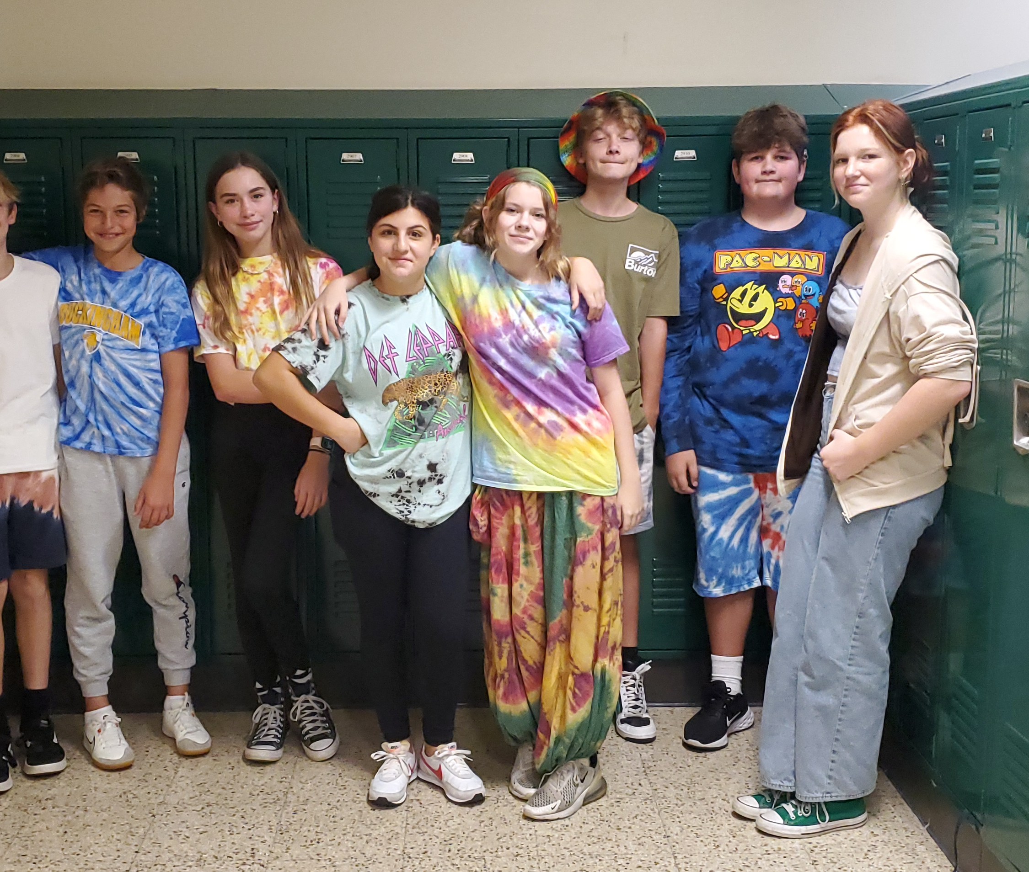
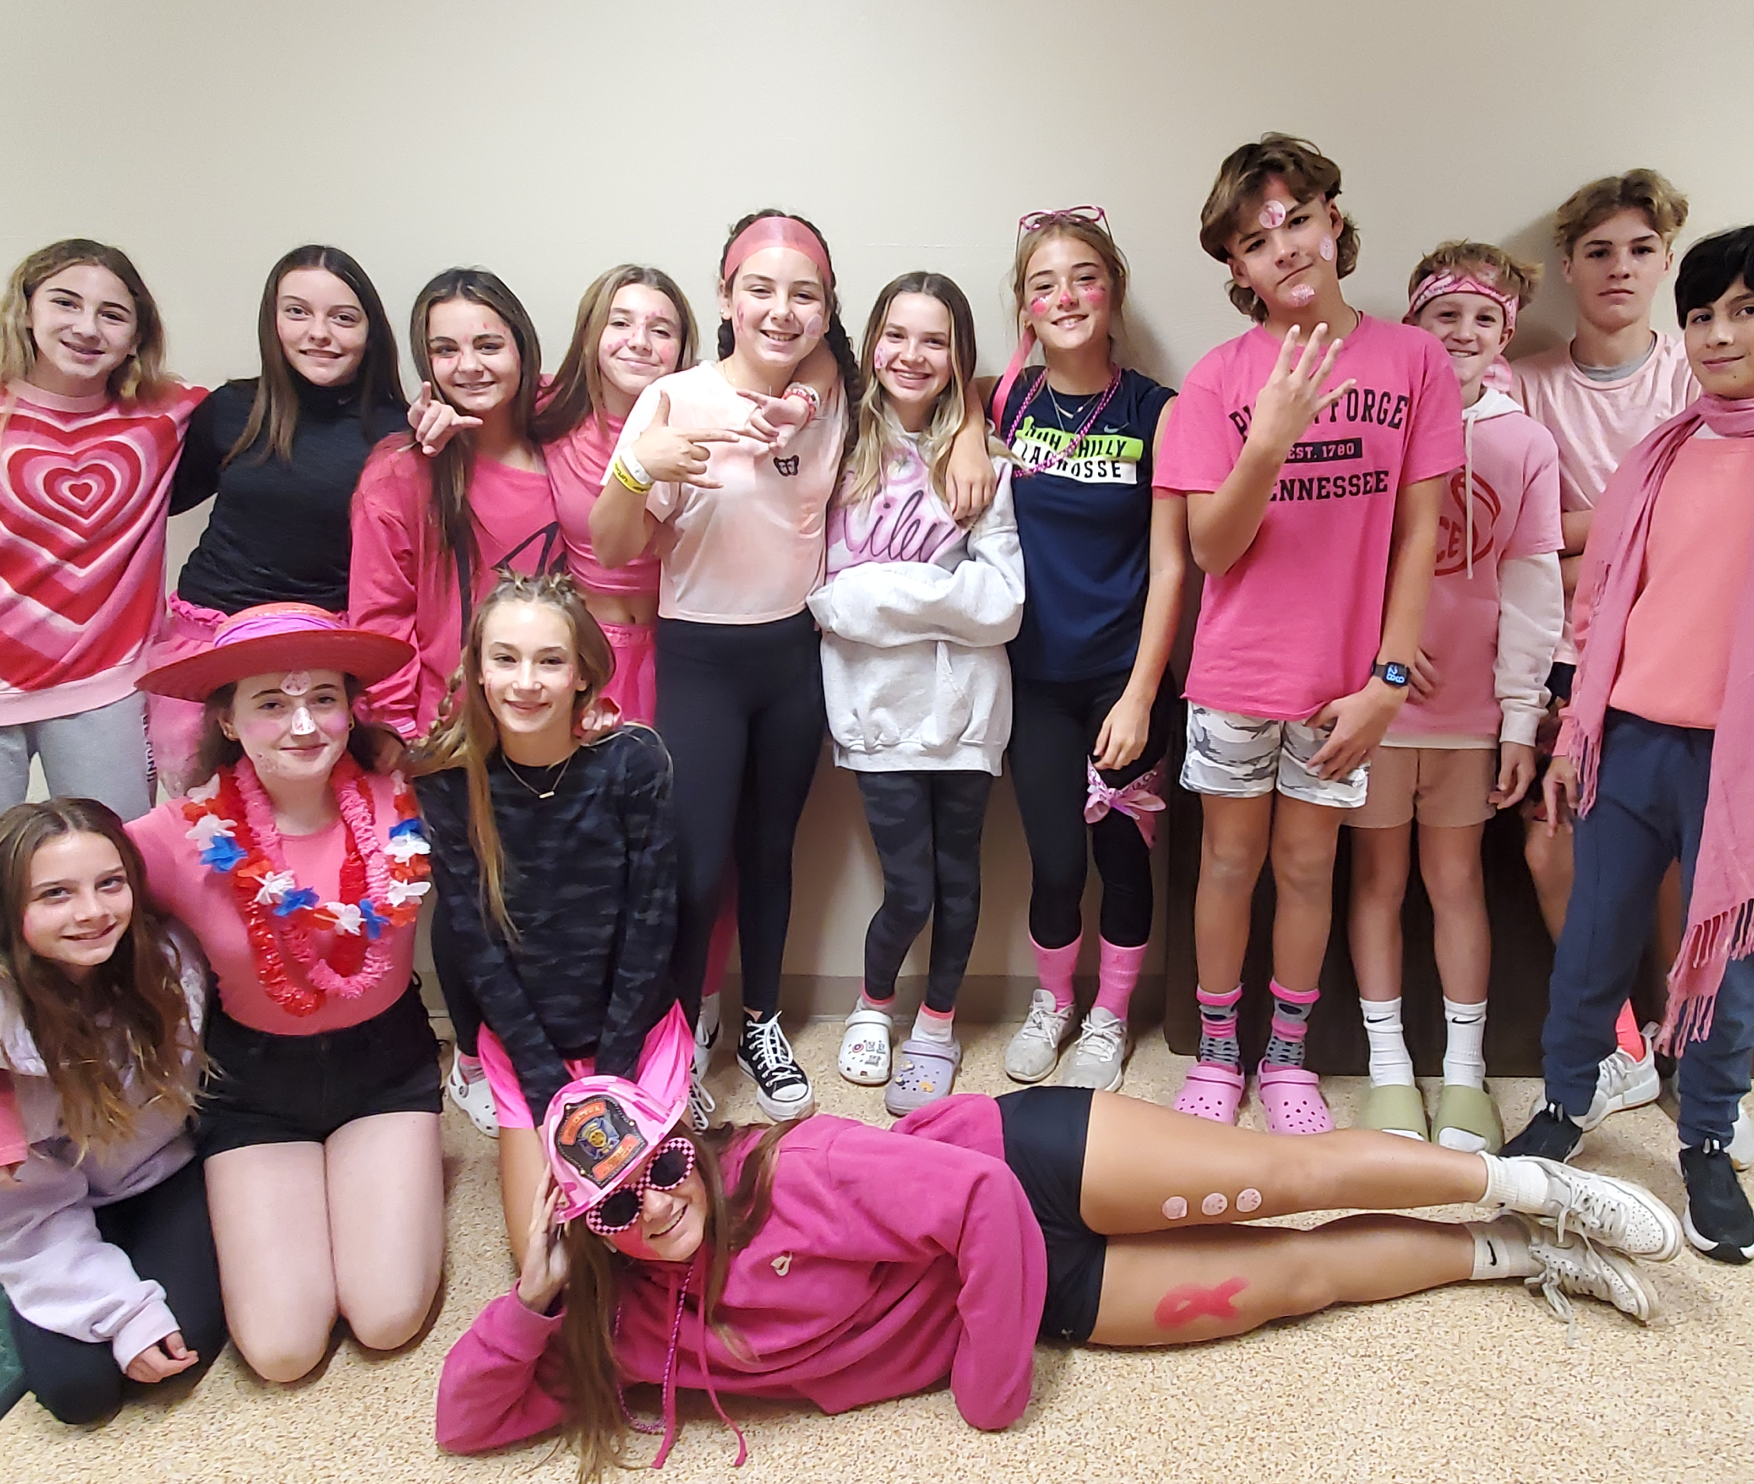
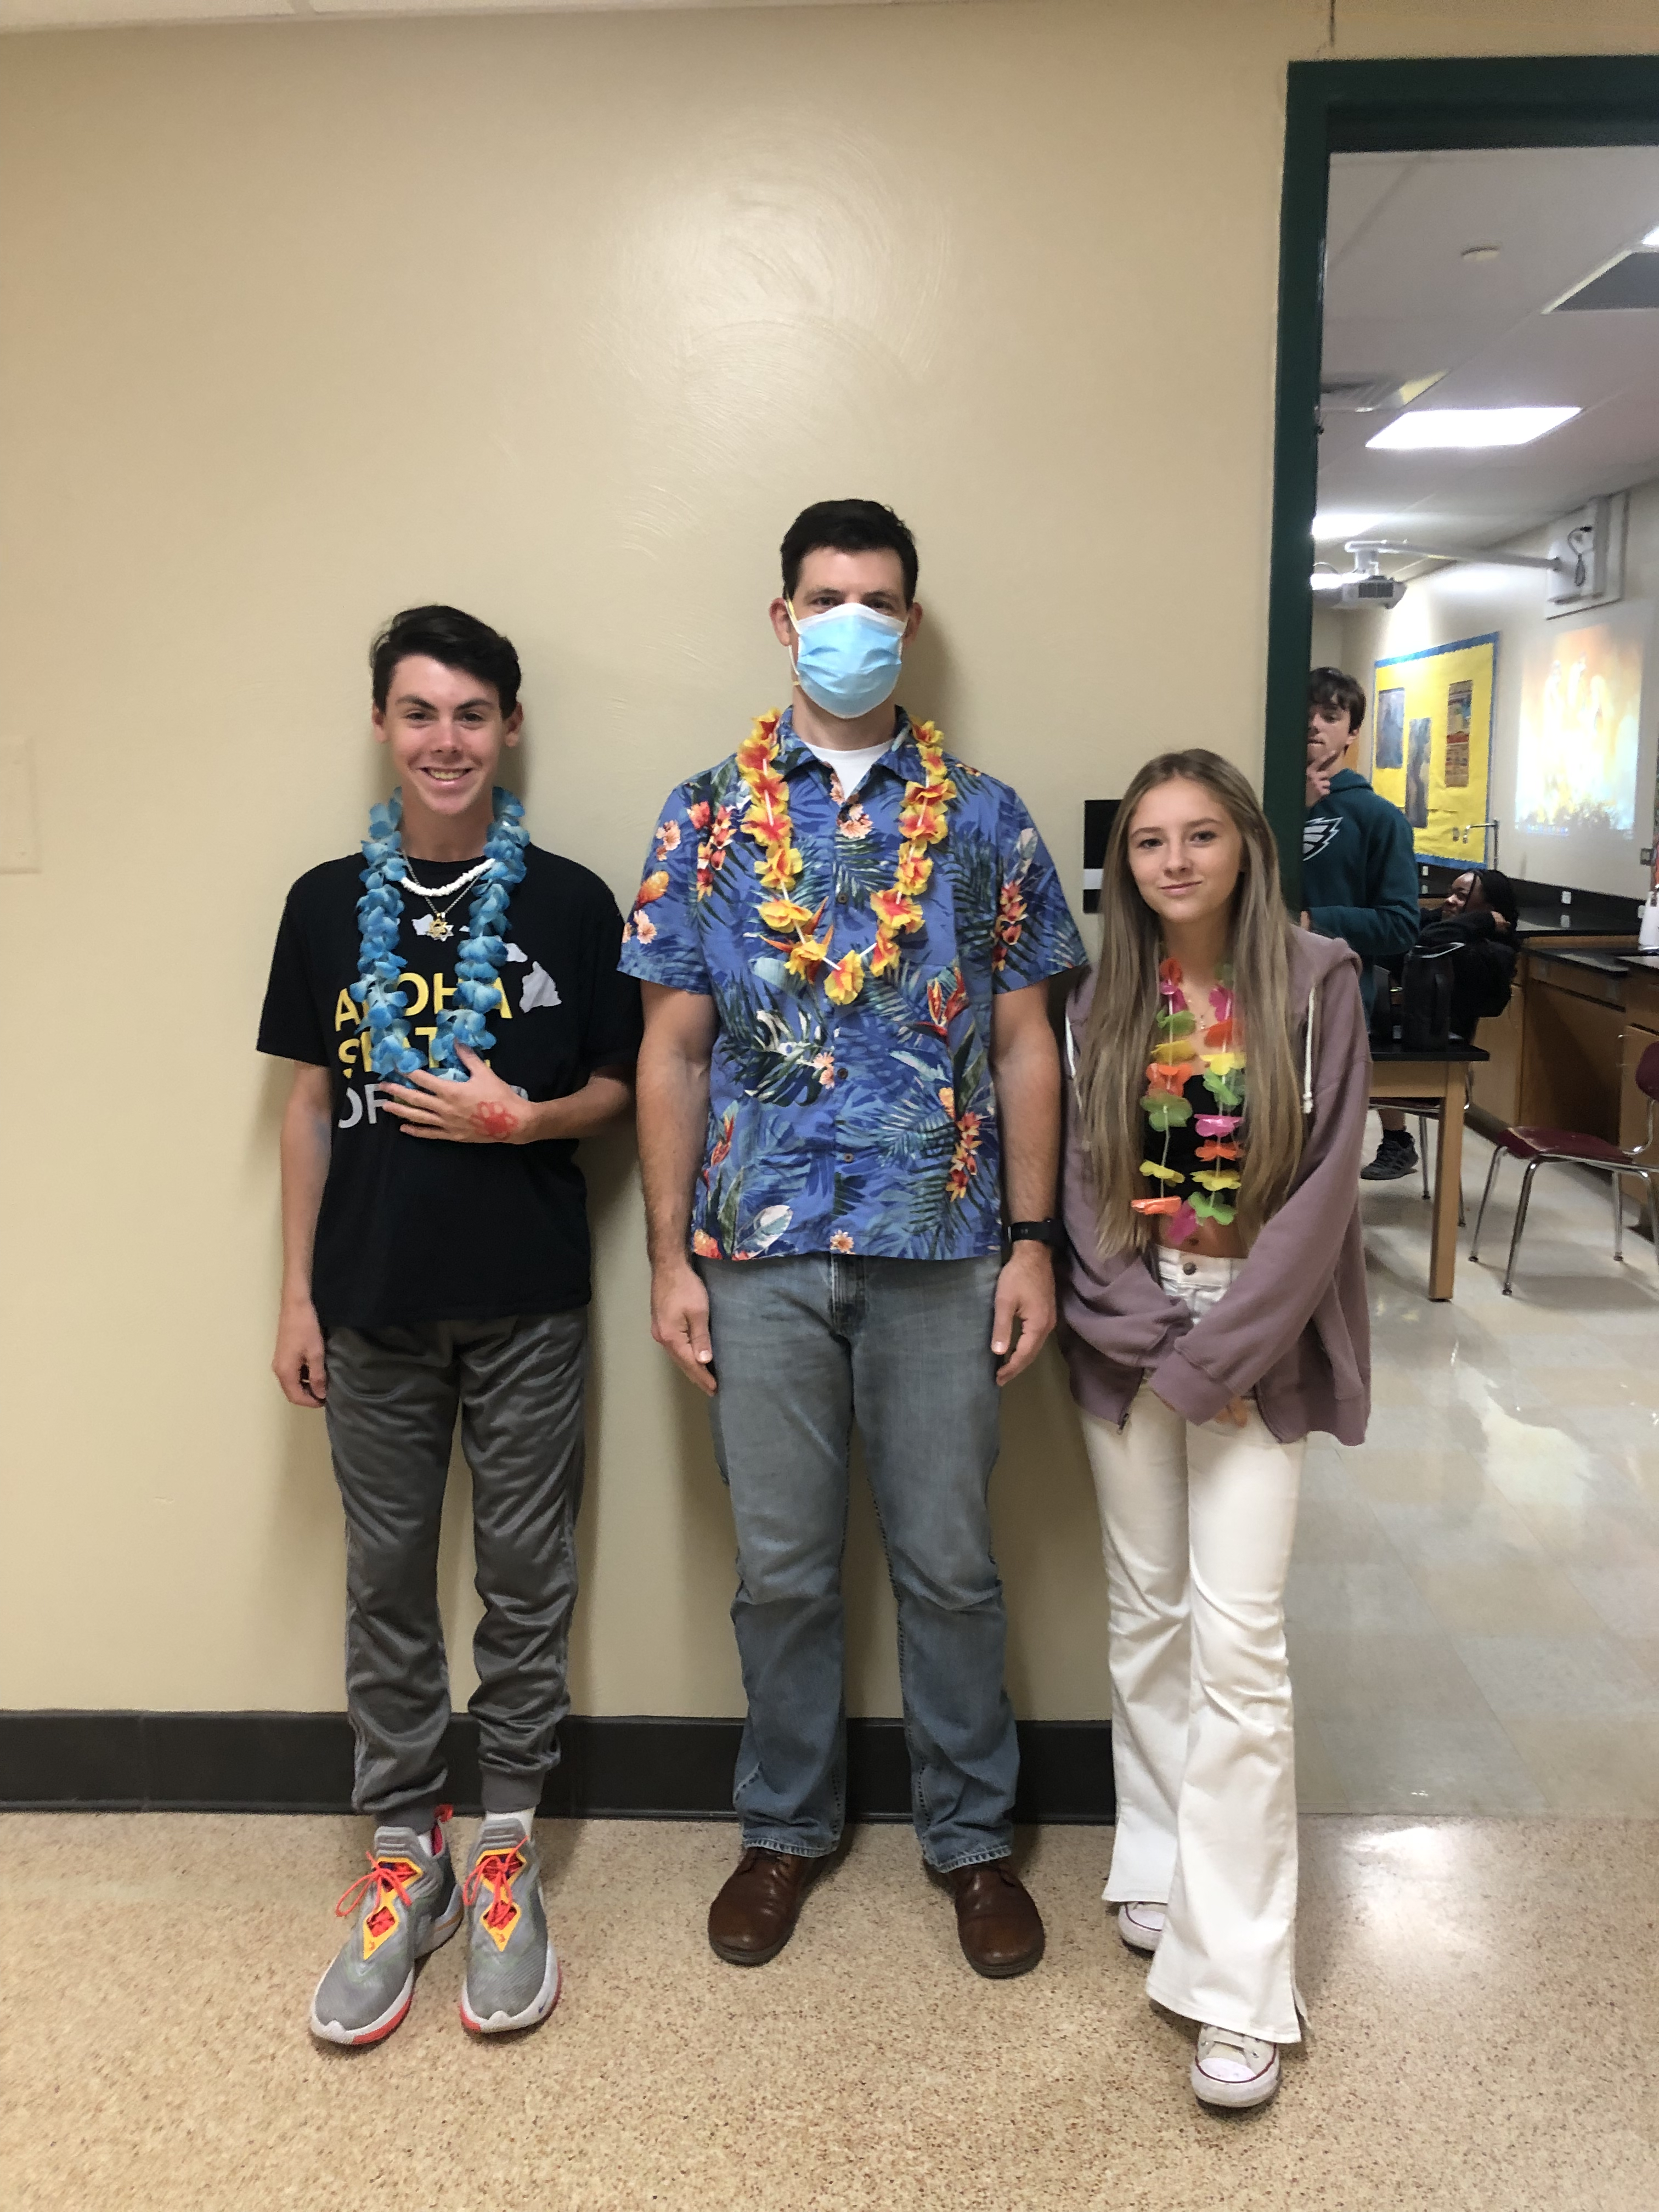
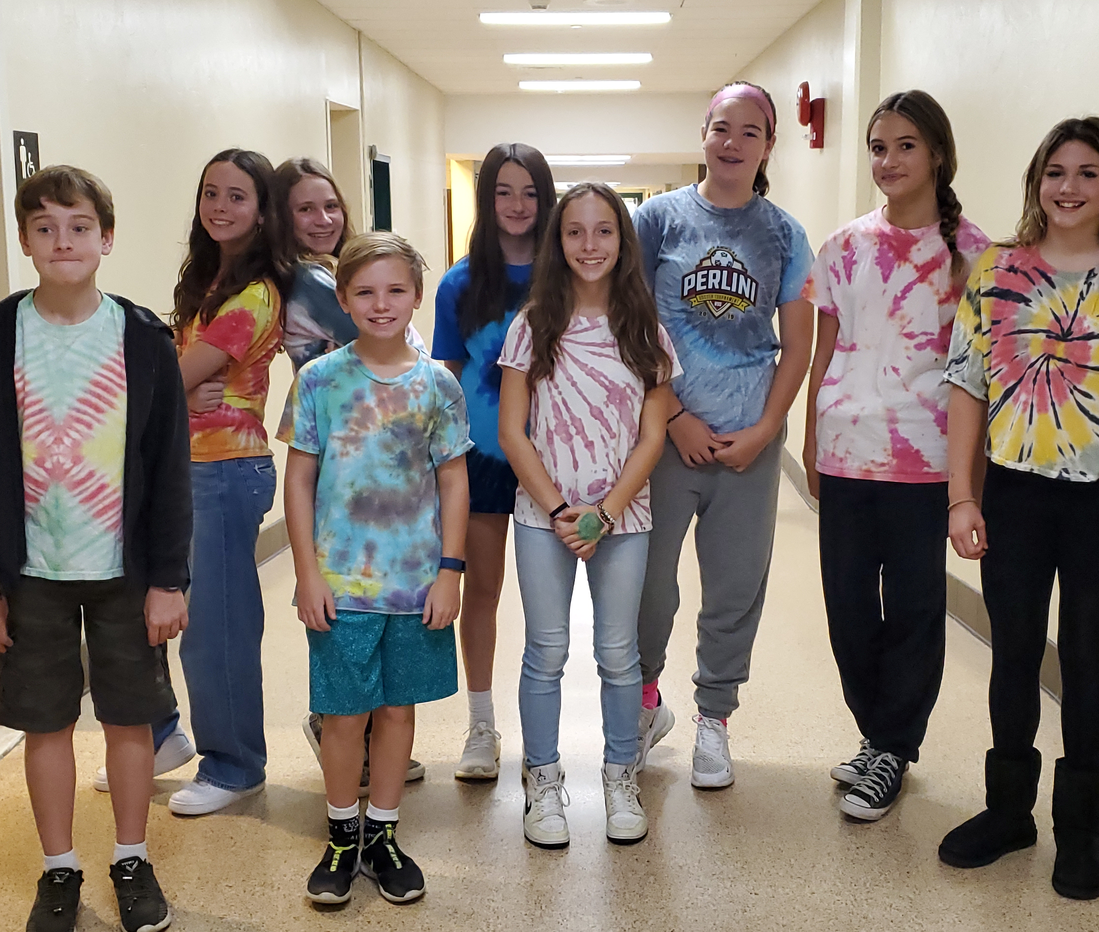

Slide 14
Student Activities Mrs. Wentz & Club Advisors
Student Activities / Activities Overview (cbsd.org) (List of clubs & activities as of fair and how to create a club form for students)
Upcoming events:
Halloween costume contest
First Responders breakfast
Cookie Dough Delivery – Wednesday November

Slide 15
Student Services Mrs. Louderback, Mr. Striano, Mrs. Pierangeli, Mrs. Chickanosky
Groups: Stress Management
Friendship
Family Support
Bereavement
Study Skills
Wellness
Consult Overview: Resource document to review this first term and share with parents
Classroom Visits

Slide 16
Holicong Staff Opportunities

Slide 17
School Business & Updates A look at what we do based on last meeting
1 Day in Resource…
A Look at Diwali - Parent Resources / Faces of Holicong (cbsd.org)
Academic Consult - Academic Check-in Grades (Web view)
Volunteers for Future Faces of Holicong – Interested?
1 Day in Wellness I & E…
10.14.22 School Wellness - First Responders and Manion.Bednarzyck.docx
Other Wellness Ideas?
1 Day in Leadership…
Issue Addressed: Maximizing support and teacher focus on students with intervention
Discussion: Creating smaller/equitable class sizes
Decision & Task: End of 1st marking period rer-roster students on team based on academic data
Discussion topics for Leadership?

Slide 18
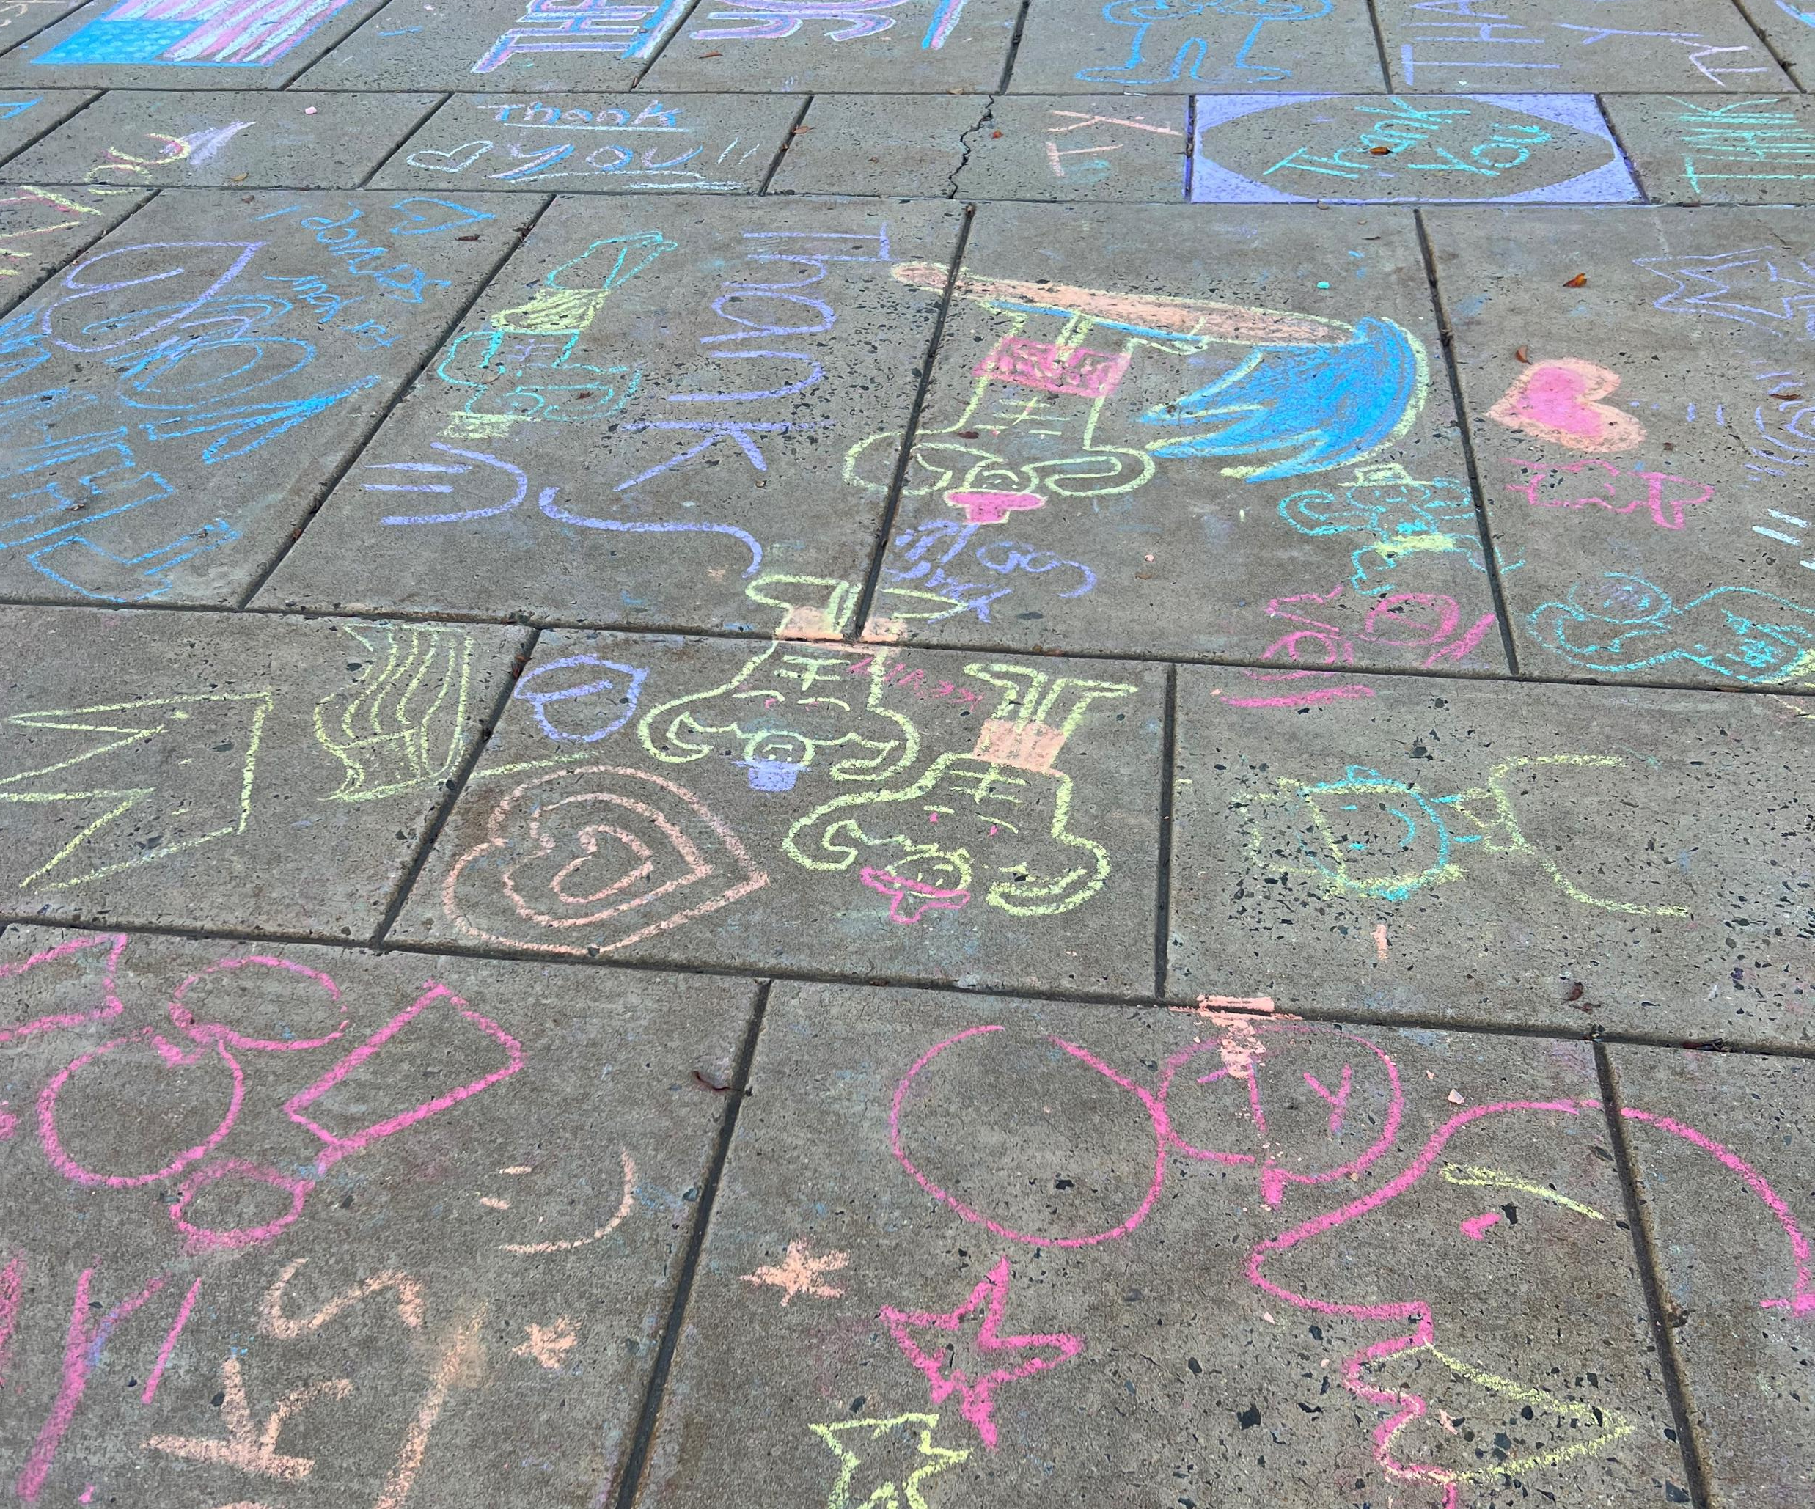
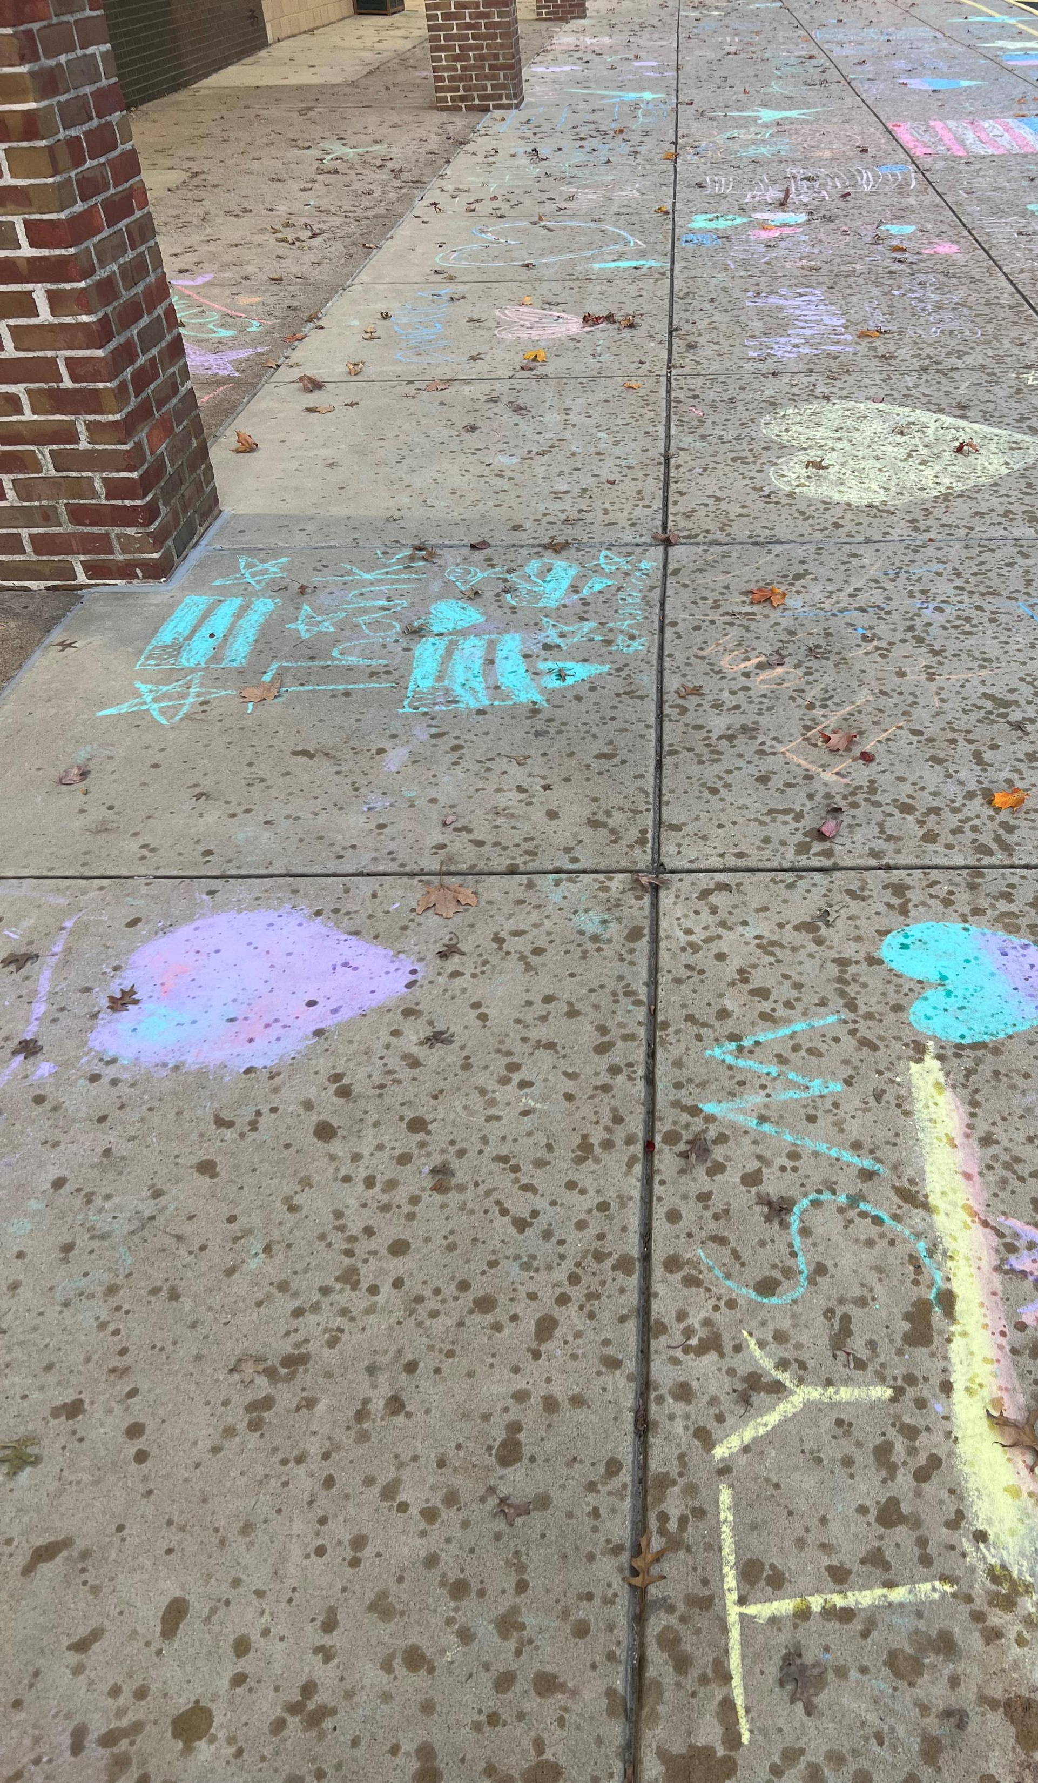
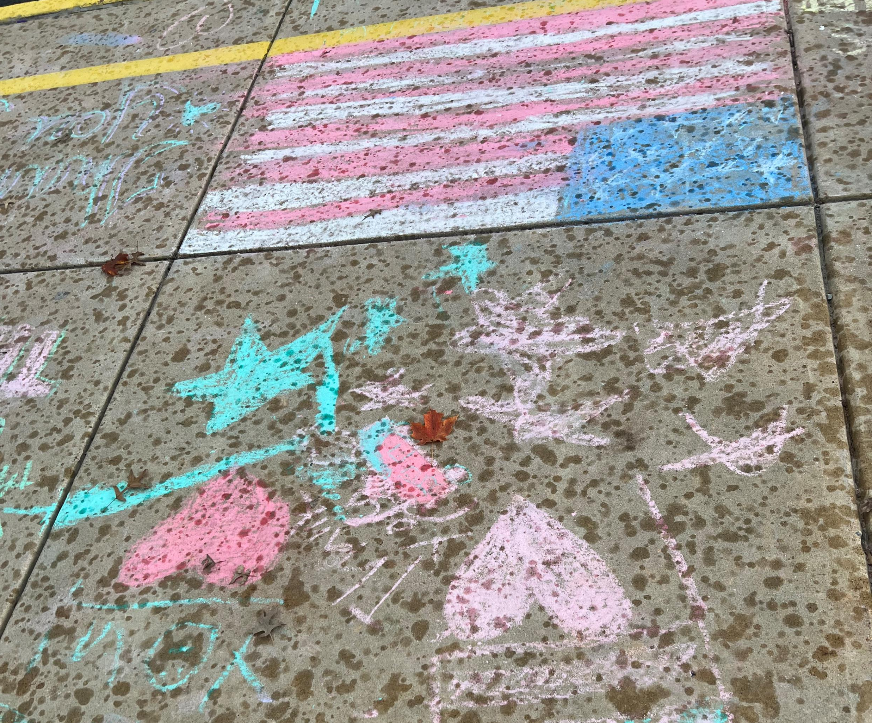
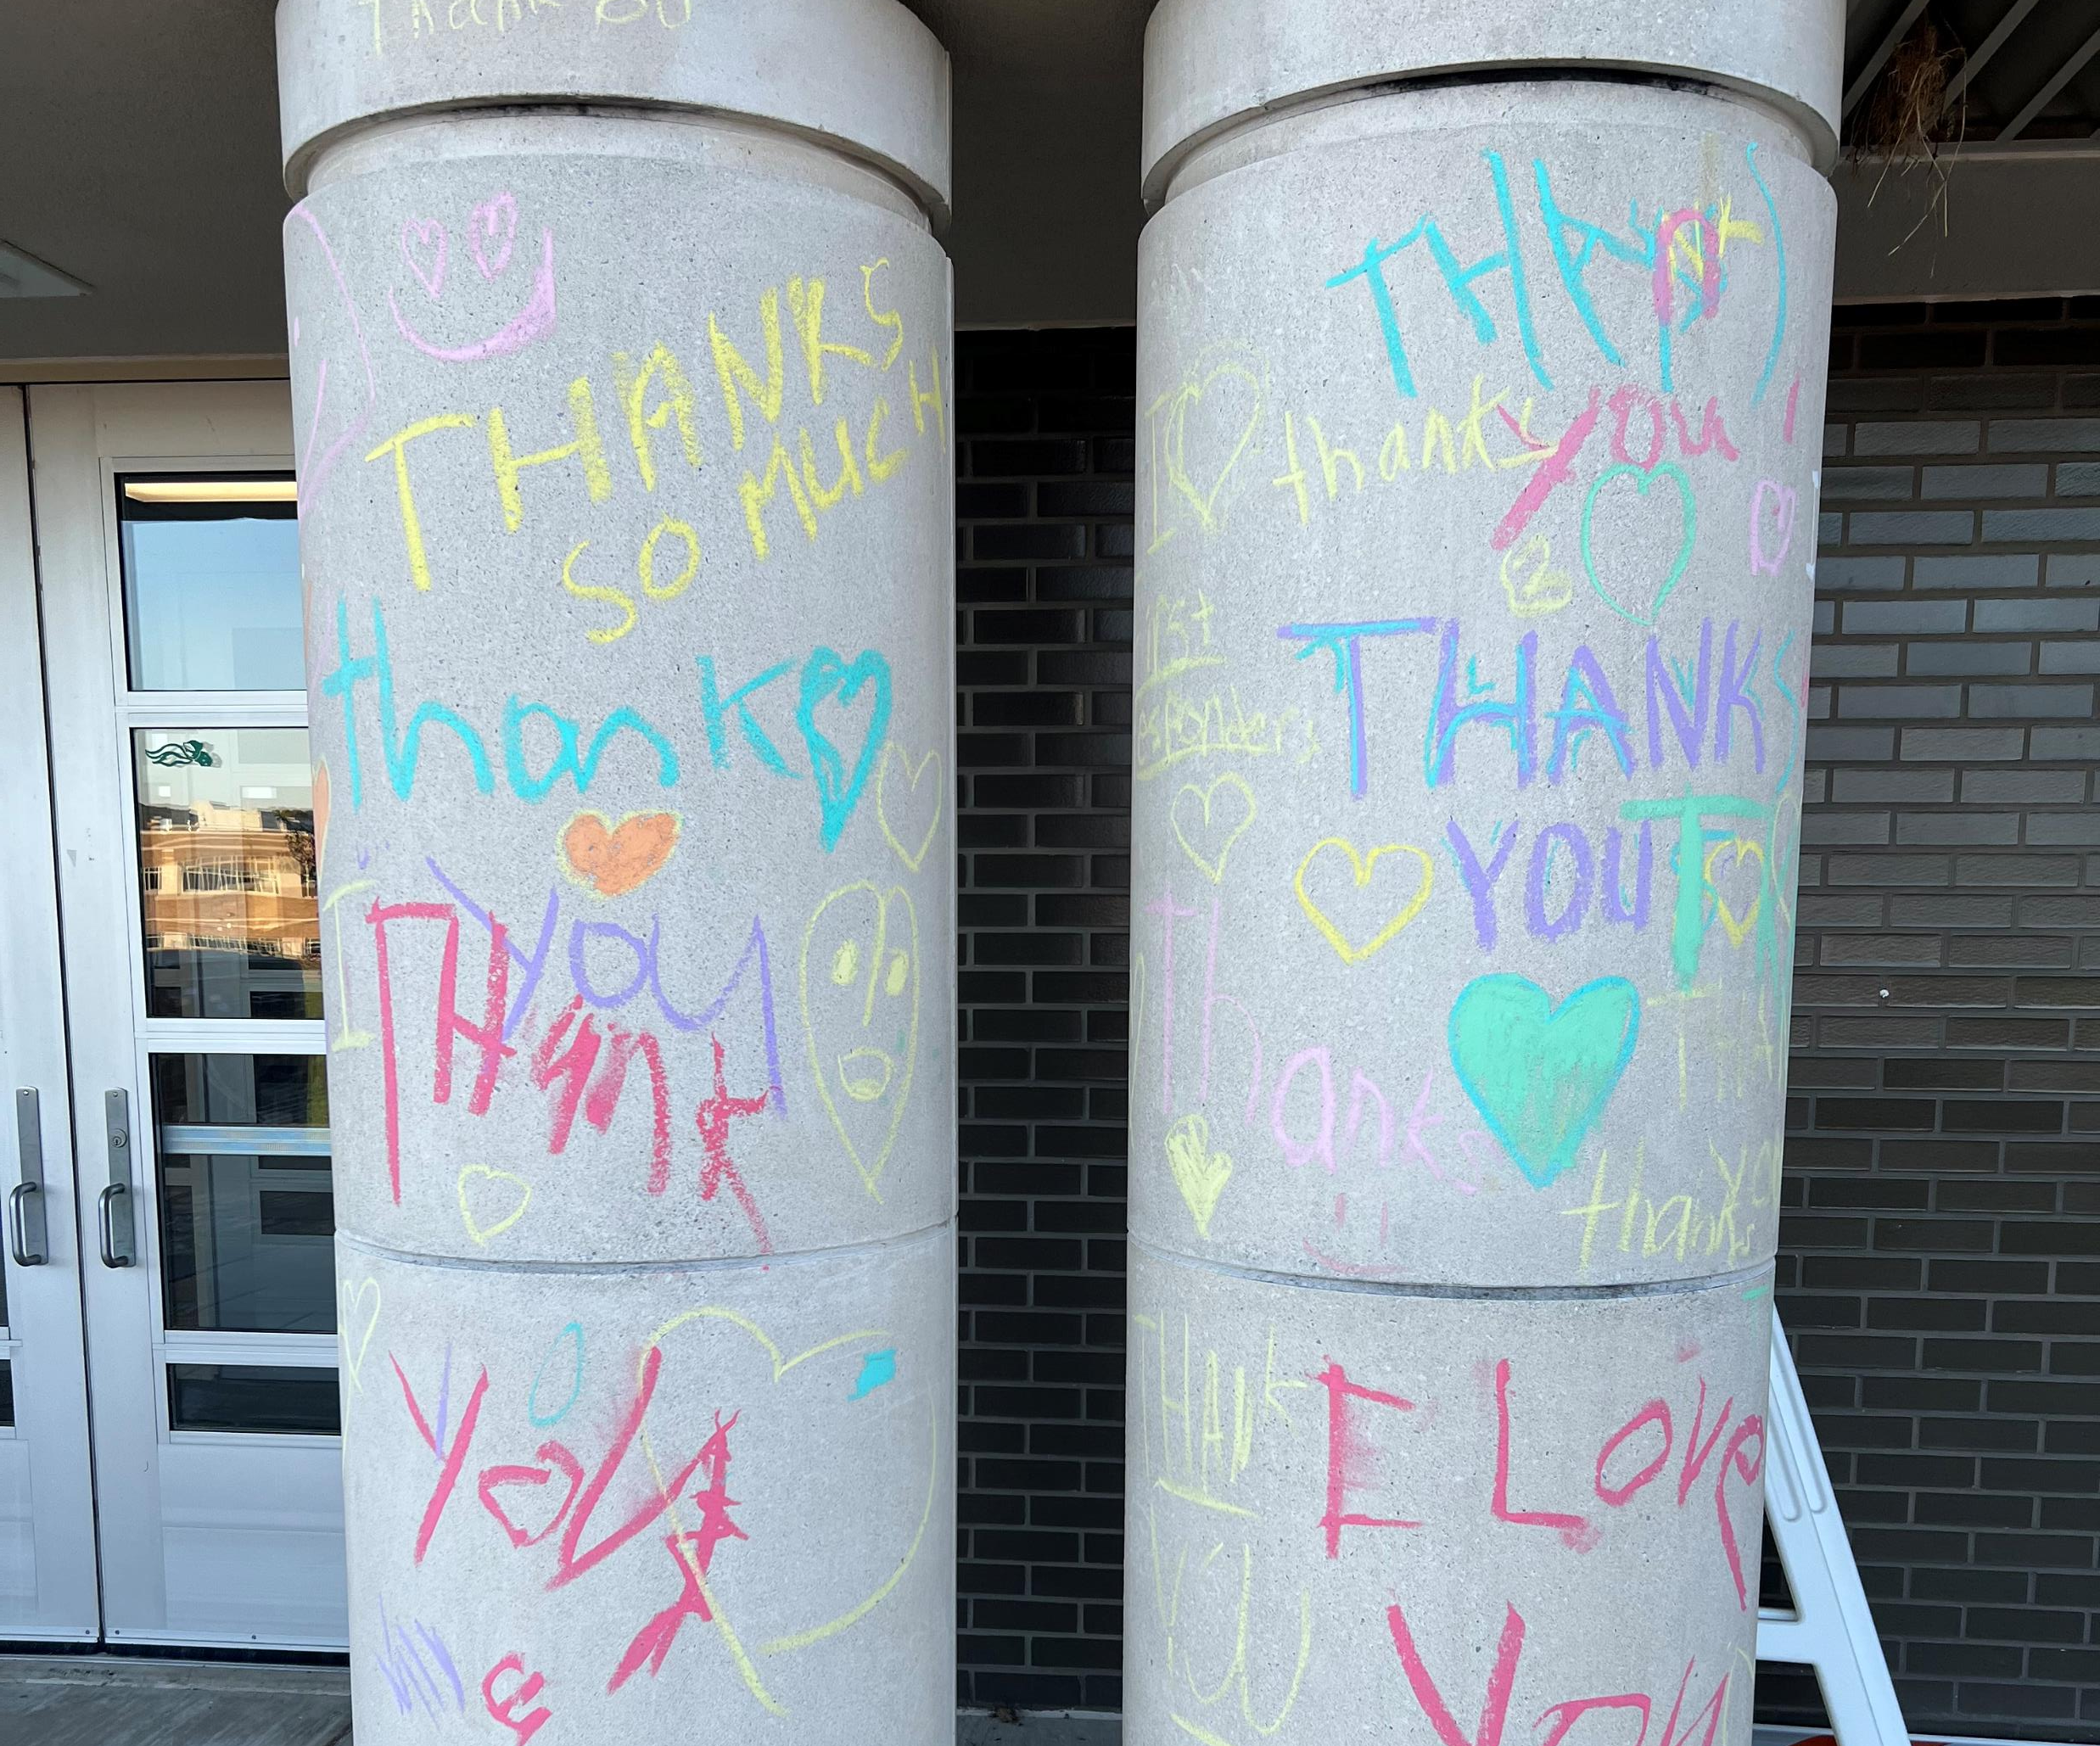

Slide 19
Box Tops for Holicong!

Slide 20
FAQ

Slide 21
FAQ

Slide 22
FAQ

Slide 23
HOLICONG MIDDLE SCHOOL PARENT COUNCIL
October 20, 2022

Slide 24
Teaching & Learning Mr. Canelli & Dr. Shillingford
What is SWPBIS?
SWPBIS stands for School-Wide Positive Behavior Interventions and Supports
SWPBIS is not a curriculum but it is a framework to identify needs, develop strategies, and evaluate practice toward building a positive school culture.
SWPBIS is a process for teaching children appropriate behavior and providing the supports necessary to sustain that behavior.
How does SWPBIS include your child?
Developing positive and effective student behavior is a group effort where students, teachers, support staff, administration and parents/families work collaboratively towards achieving this goal.

Slide 25
Teaching & Learning Mr. Canelli & Dr. Shillingford
When did the Colonial Cores start?
School Year 2018 – 2019 – Holicong works with the Bucks County Intermediate Unit to form SWPBIS team and determine needs of the school.
School Year 2019 – 2020 - Group of Holicong teachers and staff worked as a group with Bucks County Intermediate Unit to revisit the core values of the Holicong Community. Their work led to the implementation of the Colonial Cores. These core values: Considerate, Healthy, Respectful, and Responsible
School Year 2020 – 2021 – Begin to use Colonial Core terminology with students and recognize students for their positive interactions with school community.
School Year 2021 – 2022 – Class lessons on Colonial Cores and expectations in each class reviewed in advisory. Posters are placed around the school with expectations in each area. The Holicong Golden Ticket Club is formed. Teachers recognize students who are exhibiting the Colonial Cores.

Slide 26
Colonial Cores Classroom Expectations
BE RESPECTFUL
I AM AN ACTIVE LISTENER
I FOLLOW DIRECTIONS THE FIRST TIME
I PROMOTE A POSITIVE CLASSROOM ENVIRONMENT
I LEAVE MY AREA CLEAN AND RETURN ALL MATERIALS
BE RESPONSIBLE
I AM PROMPT, PREPARED, AND READY TO LEARN
I COMPLETE MY WORK ON TIME
I COMPLETE MY OWN WORK
I DEMONSTRATE EFFORT ON A CONSISTENT BASIS
BE CONSIDERATE
I LISTEN TO AND CONSIDER OTHER PEOPLE’S IDEAS, BACKGROUNDS, AND BELIEFS
I STAND UP FOR MYSELF AND OTHERS
I AM KIND, HELPFUL, AND INCLUSIVE
BE HEALTHY
I HAVE A GROWTH MINDSET
I AM MINDFUL
I AM KIND, PATIENT, AND UNDERSTANDING WITH MYSELF
I REACH OUT FOR HELP WHEN NEEDED

Slide 27
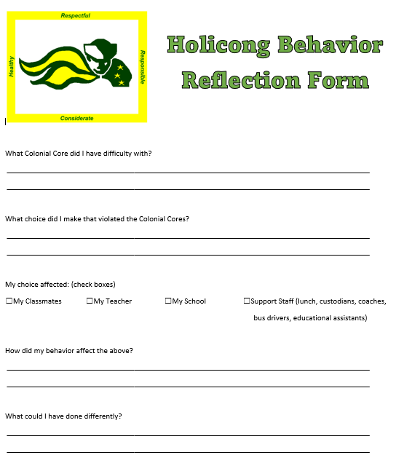
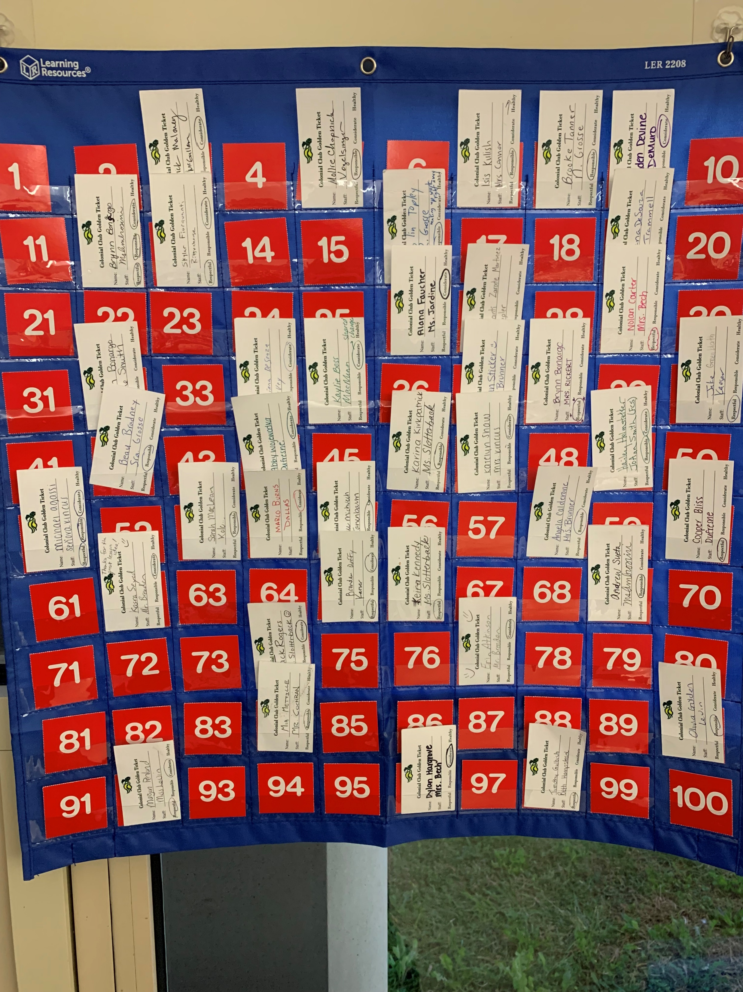
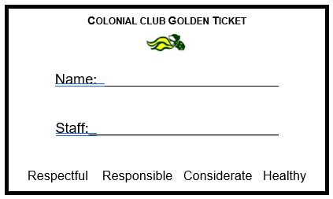
Positive Behavior Intervention
Positive
Restorative

